Slide 1
Texas Veterans Hall of Fame: Remember Them Forever (RTF) Project
Narrated by Diana Mason, PhD, ACSF
Hosted by the Texas Veterans Hall of Fame

Slide 2
Official State Flag (1933 to present)

Slide 3
Texas Flag Trivia
Moniker/Nickname: The Lone Star State
Star summons unity in the fight for independence against Mexico.
Colors, inspired by the United States flag:
"Old Glory Blue" for loyalty,
"Old Glory Red" for bravery and
white for purity.
Flag code also states:
Single (lone) star "represents ALL of Texas and stands for our unity as one for God, State, and Country."

Slide 4
Texas Veterans Hall of Fame (TVHOF)

Slide 5
Who is the Texas Veterans Hall of Fame (TVHOF)?
TVHOF is a 501(c)3 organization dedicated to preserving and honoring the stories of all Texas Veterans. You can visit their website at www.tvhof.org.

Slide 6
TVHOF Mission Statement
To honor all Texas Veterans for their service, sacrifices and accomplishments.
To preserve the history and stories of our Texas Veterans.
To educate the public on those stories

Slide 7
Remember Them Forever
Remember Them Forever (RTF) – our signature and marker program to honor our veterans.
For those who are deceased a 6” marker is placed on the grave. This marker has a QR Code on it and when scanned it takes the visitor to the profile about that Veteran.
We know of no one else having such a program. It also provides an opportunity for individual and/or civic nonprofits organizations to host and record the biographical information on the veterans lives and contributions.
We currently have 21 cemeteries. Most of the veteran-identified gravesites are entered into the TVHOF database providing the beginnings of over 3,500 profiles (See: http://txveterans.org)
Patriot Medallions: over 700 can be found in just two City of Denton cemeteries (Oakwood and IOOF).
Roselawn Cemetery in Seagoville contributes over 1100 veterans to the TVHOF database but needs someone/some organization willing to adopt! Interested?

Slide 8
Team Partners
RFT #1: Colonial Dames XVII Century Star of Destiny Chapter.
Do you want to join the RTF Team?
Go to: https://txveterans.org/remember-them-forever/
RTF Project
Do you need suggestions for a service project?
Do you need community service hours?
Do you have a cemetery in mind?
If so, think about joining the RTF Team!

Slide 9
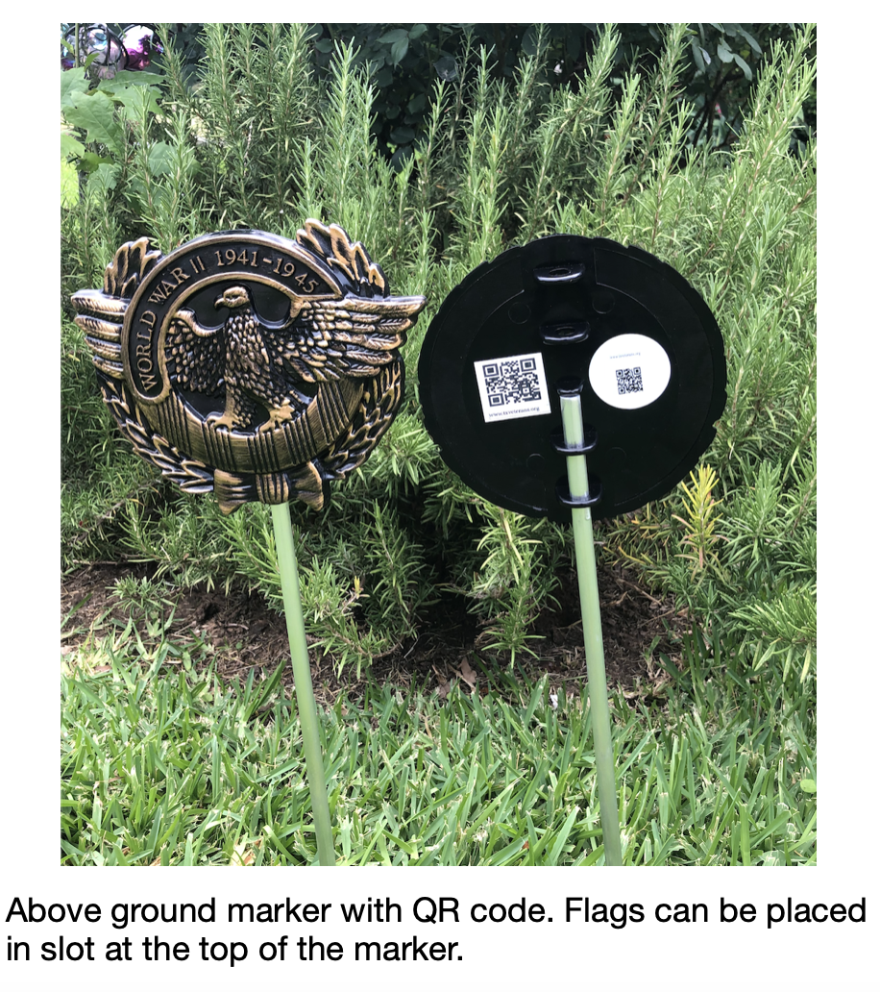
Patriot Medallions (Examples)
Markers may be purchased at the Museum’s store!
If you adopt a cemetery, a marker with a flag is $10 x n!

Slide 10
Patriot Medallions
A hard-core plastic marker for each of the different wars or conflicts.
A 6”×6” marker with a rod that allows the marker to be placed near the grave headstones and a place on top to house the American Flag or service flag of that Veteran.
On the back of the medallion there is a QR code that is pointed to the profile of that veteran that is buried in that grave.
While visiting that grave, visitors can scan the QR code and read about that veteran while visiting that grave.

Slide 11
Adopt a Cemetery
Decide that you are willing and able to place Patriot Medallions with flags and assure that the flags are well cared for and flown for at least three days on either side of Memorial Day, July 4th and Veterans Day.
Obtain permission from the appropriate cemetery organization/personnel to place the Markers with flags.
Cover the initial cost of the RTF project.
Place the Markers so as to avoid mowers as best as possible; be willing to replace markers that are damaged or missing.
Also purchase QR codes for the back of the medallions that link to the TVHOF database and the biographical information for that veteran. (About $0.50 each.)
If allowed, purchase RTF panel(s) for the cemetery that are displayed at the cemetery providing the GPS location of each veteran buried at that cemetery. (About $100 per panel; large cemeteries may require more than one!)

Slide 12
Panel Displays
The panel display is a large metal sign that provides information about the RTF program and how the QR code works.
Several of these signs can be placed in strategic places throughout the cemetery.
Recognition of the RTF Host will be highlighted on the display marker as well.
For examples, visit Oakwood Cemetery located in the City of Denton.

Slide 13
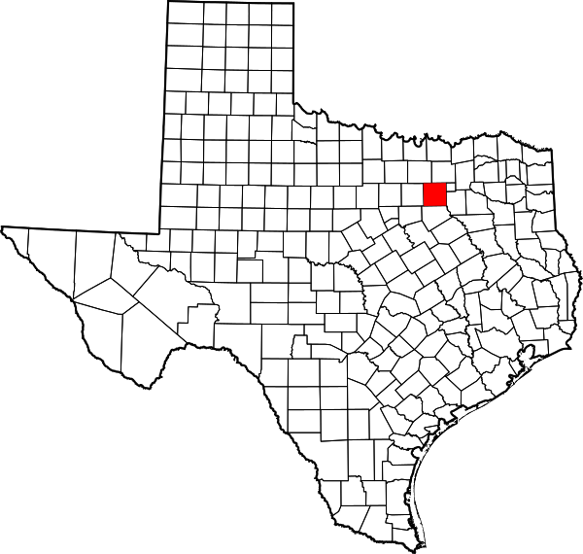
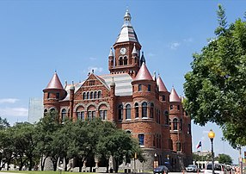
Dallas County
Dallas, Texas

Slide 14
Dallas County
Roselawn Cemetery, Seagoville

Slide 15
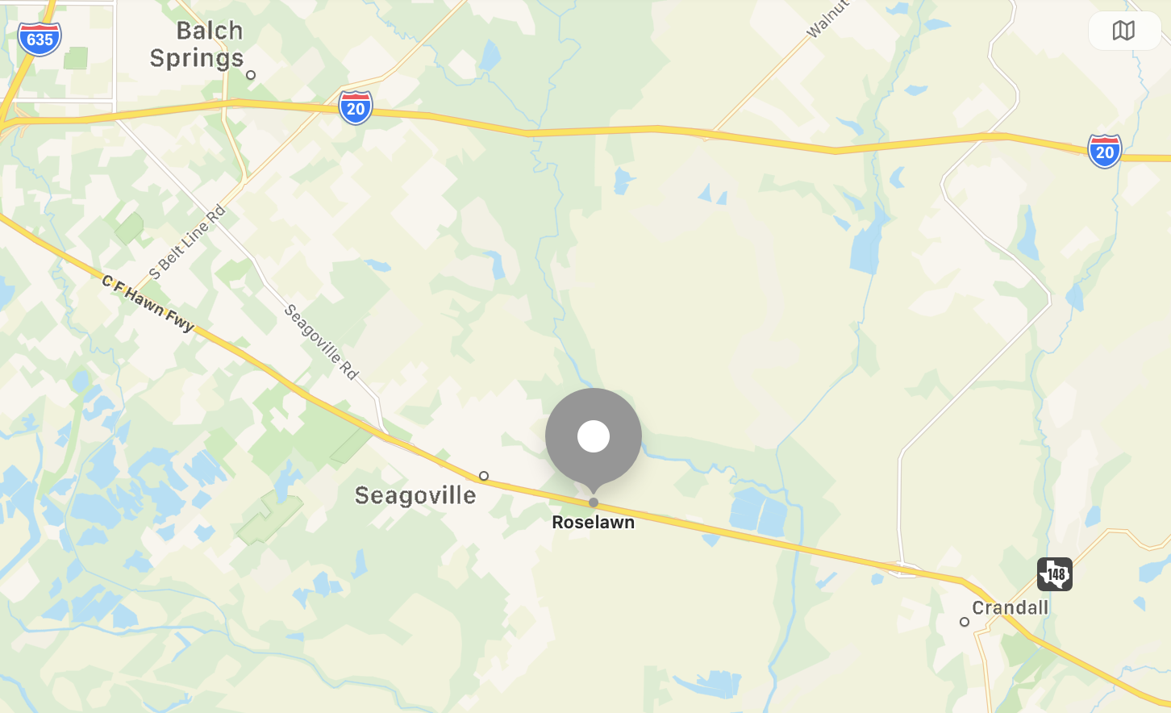
Roselawn Memorial Gardens
1100 veterans identified of 5536 occupants
21% veterans
Conflicts: 1133
Texas Revolution:
Mexican-American:
Civil War:
Indian Wars:
Spanish-American:
WW I: 23
WW II: 596
Korea: 201
Vietnam: 153
War on Terror: 1
Peace time or Unknown: 159
Note: Total exceeds number of identified veterans because some served during more than one conflict.
Address
1000 S US 175 Frontage Rd.
Seagoville, Texas 75159
Adoption cost: $11,330 + $550.00 for QR codes = $11,880 + panels

Slide 16
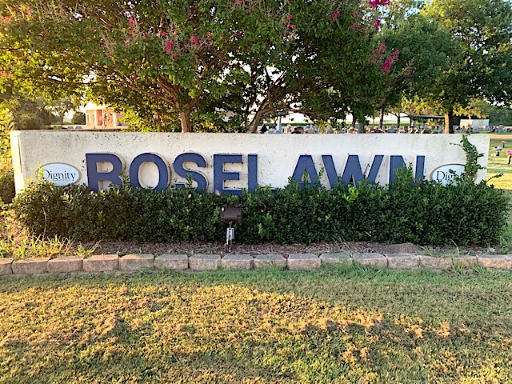
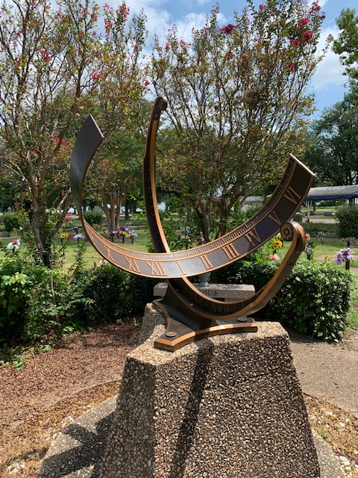
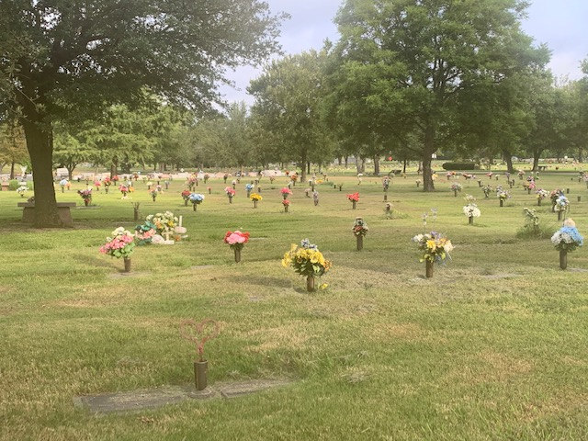
Summer 2021

Slide 17
Dallas County
Lee Cemetery, Seagoville

Slide 18
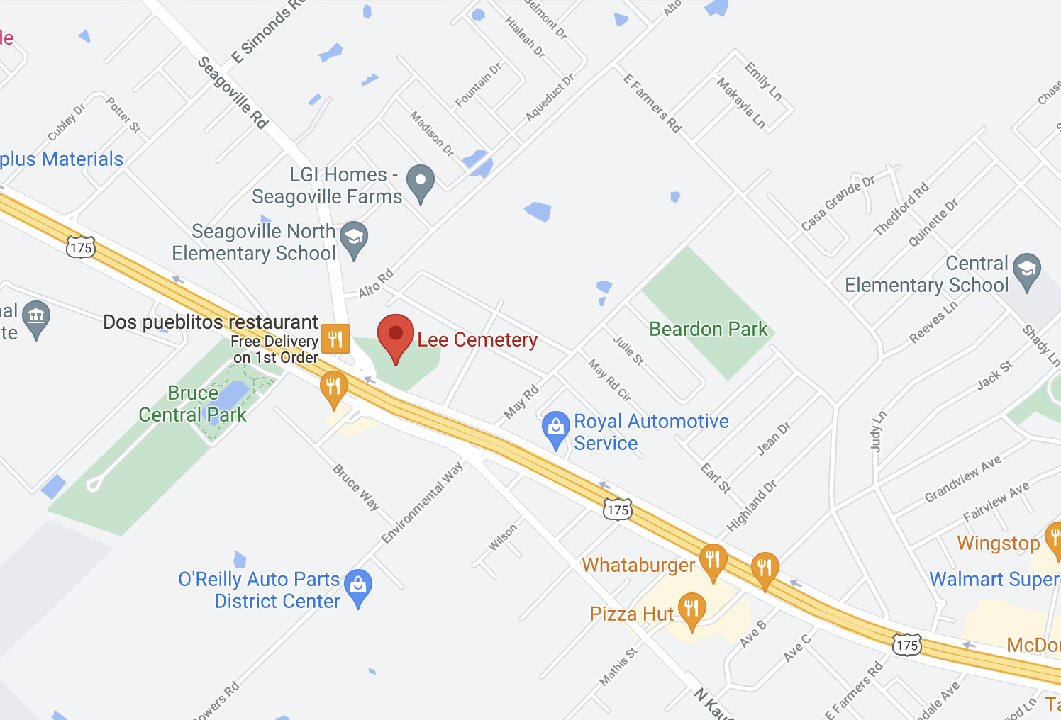
Lee Cemetery
101 veterans identified of 1549 occupants
6% veterans
Conflicts: 103
Texas Revolution:
Mexican-American:
Civil War: 2
Indian Wars:
Spanish-American:
WW I: 19
WW II: 52
Korea: 9
Vietnam: 6
War on Terror:
Peace time or Unknown: 15
Note: Total exceeds number of identified veterans because some served during more than one conflict.
Address
1706 Seagoville Rd
Seagoville, Texas 75159
Adoption cost: $1010 + $50.50 for QR codes = $1060.50 + panels

Slide 19
Summer 2021

Slide 20
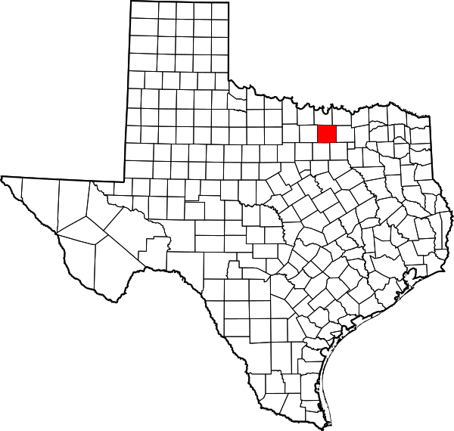
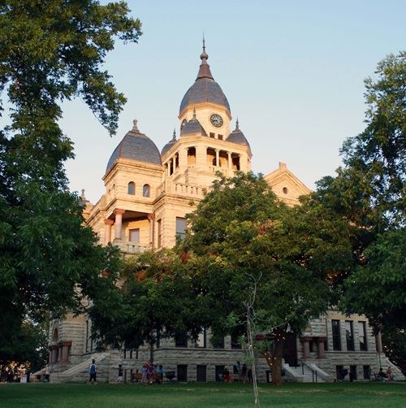
Denton County
Denton, Texas

Slide 21
Denton County
Oakwood Cemetery, Denton

Slide 22
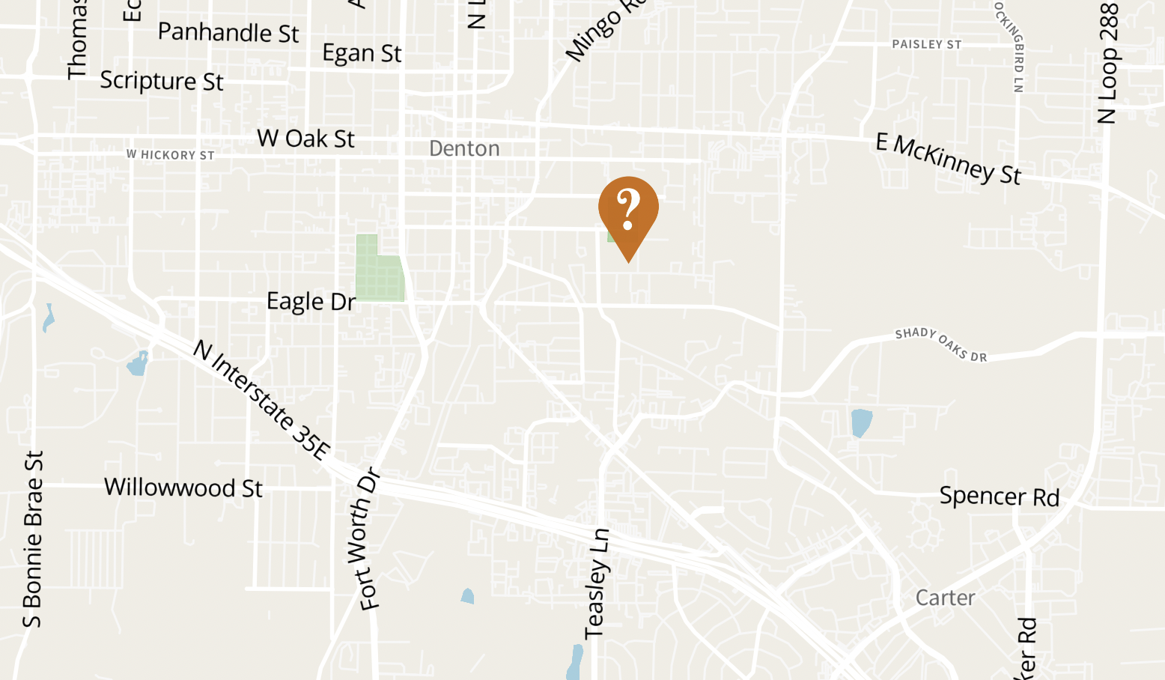
Oakwood Cemetery (RTF #1)
287 veterans identified of 4822 occupants
6% veterans
Conflicts: 291
Texas Revolution:
Mexican-American: 2
Civil War: 11
Indian Wars:
Spanish-American: 2
WW I: 59
WW II: 156
Korea: 21
Vietnam: 25
War on Terror:
Peace time or Unknown: 15
Note: Total exceeds number of identified veterans because some served during more than one conflict.
Address
747 East Prairie Street
Denton, Texas 76205
Adopted: Star of Destiny Chapter Colonial Dames XVII Century!

Slide 23
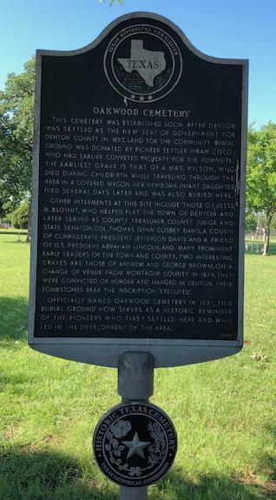
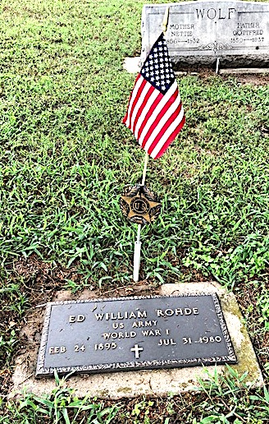
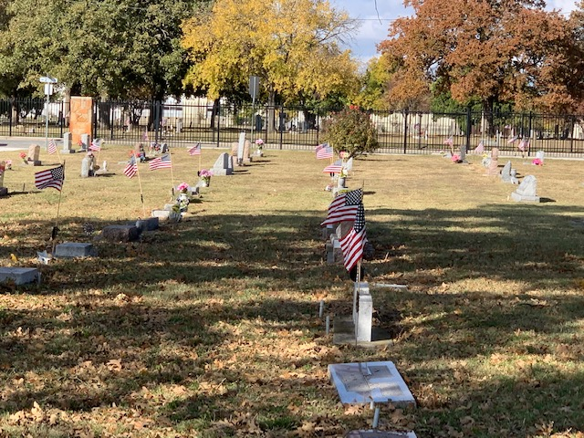
Fall 2020

Slide 24
Denton County
Independent Order of Odd Fellows (IOOF), Denton

Slide 25
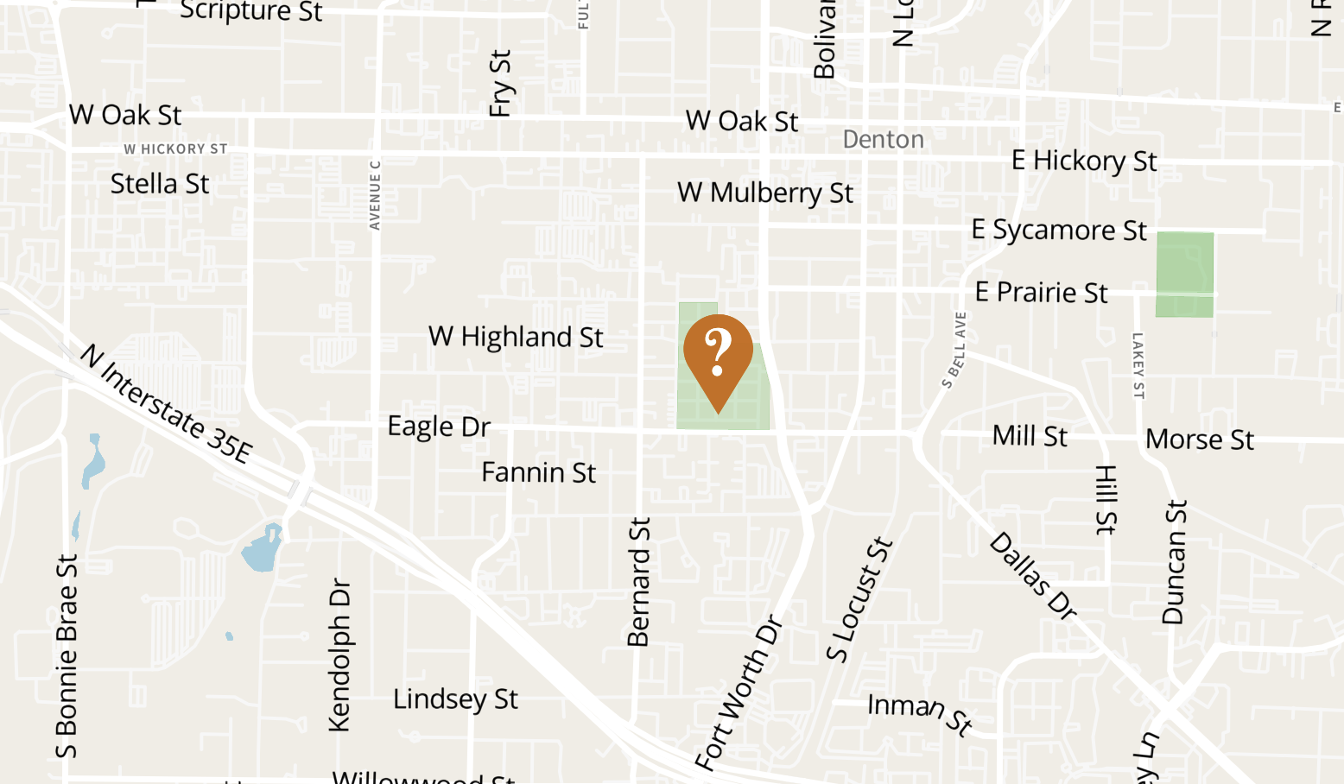
IOOF Cemetery
426 veterans identified of 7260 occupants
6% veterans
Conflicts: 443
Texas Revolution: 1
Mexican-American: 1
Civil War: 111
Indian Wars:
Spanish-American: 8
WW I: 126
WW II: 167
Korea: 14
Vietnam: 12
War on Terror:
Peace time or Unknown: 3
Note: Total exceeds number of identified veterans because some served during more than one conflict.
Address
711 S Carroll Blvd
Denton, Texas 76201
Adopted! Support for panels still needed!

Slide 26
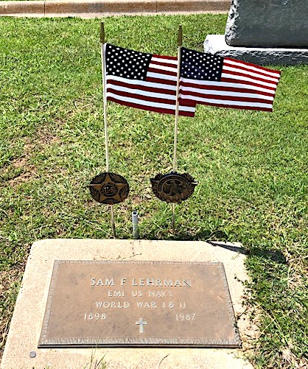
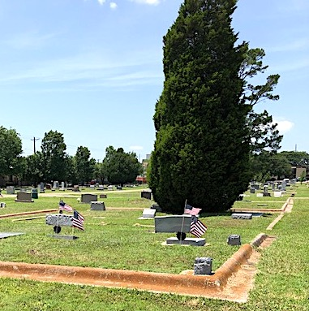
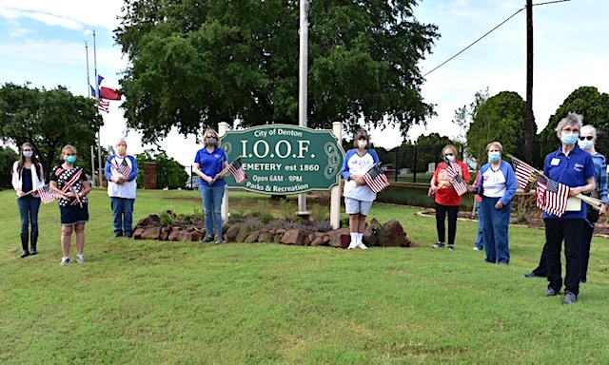
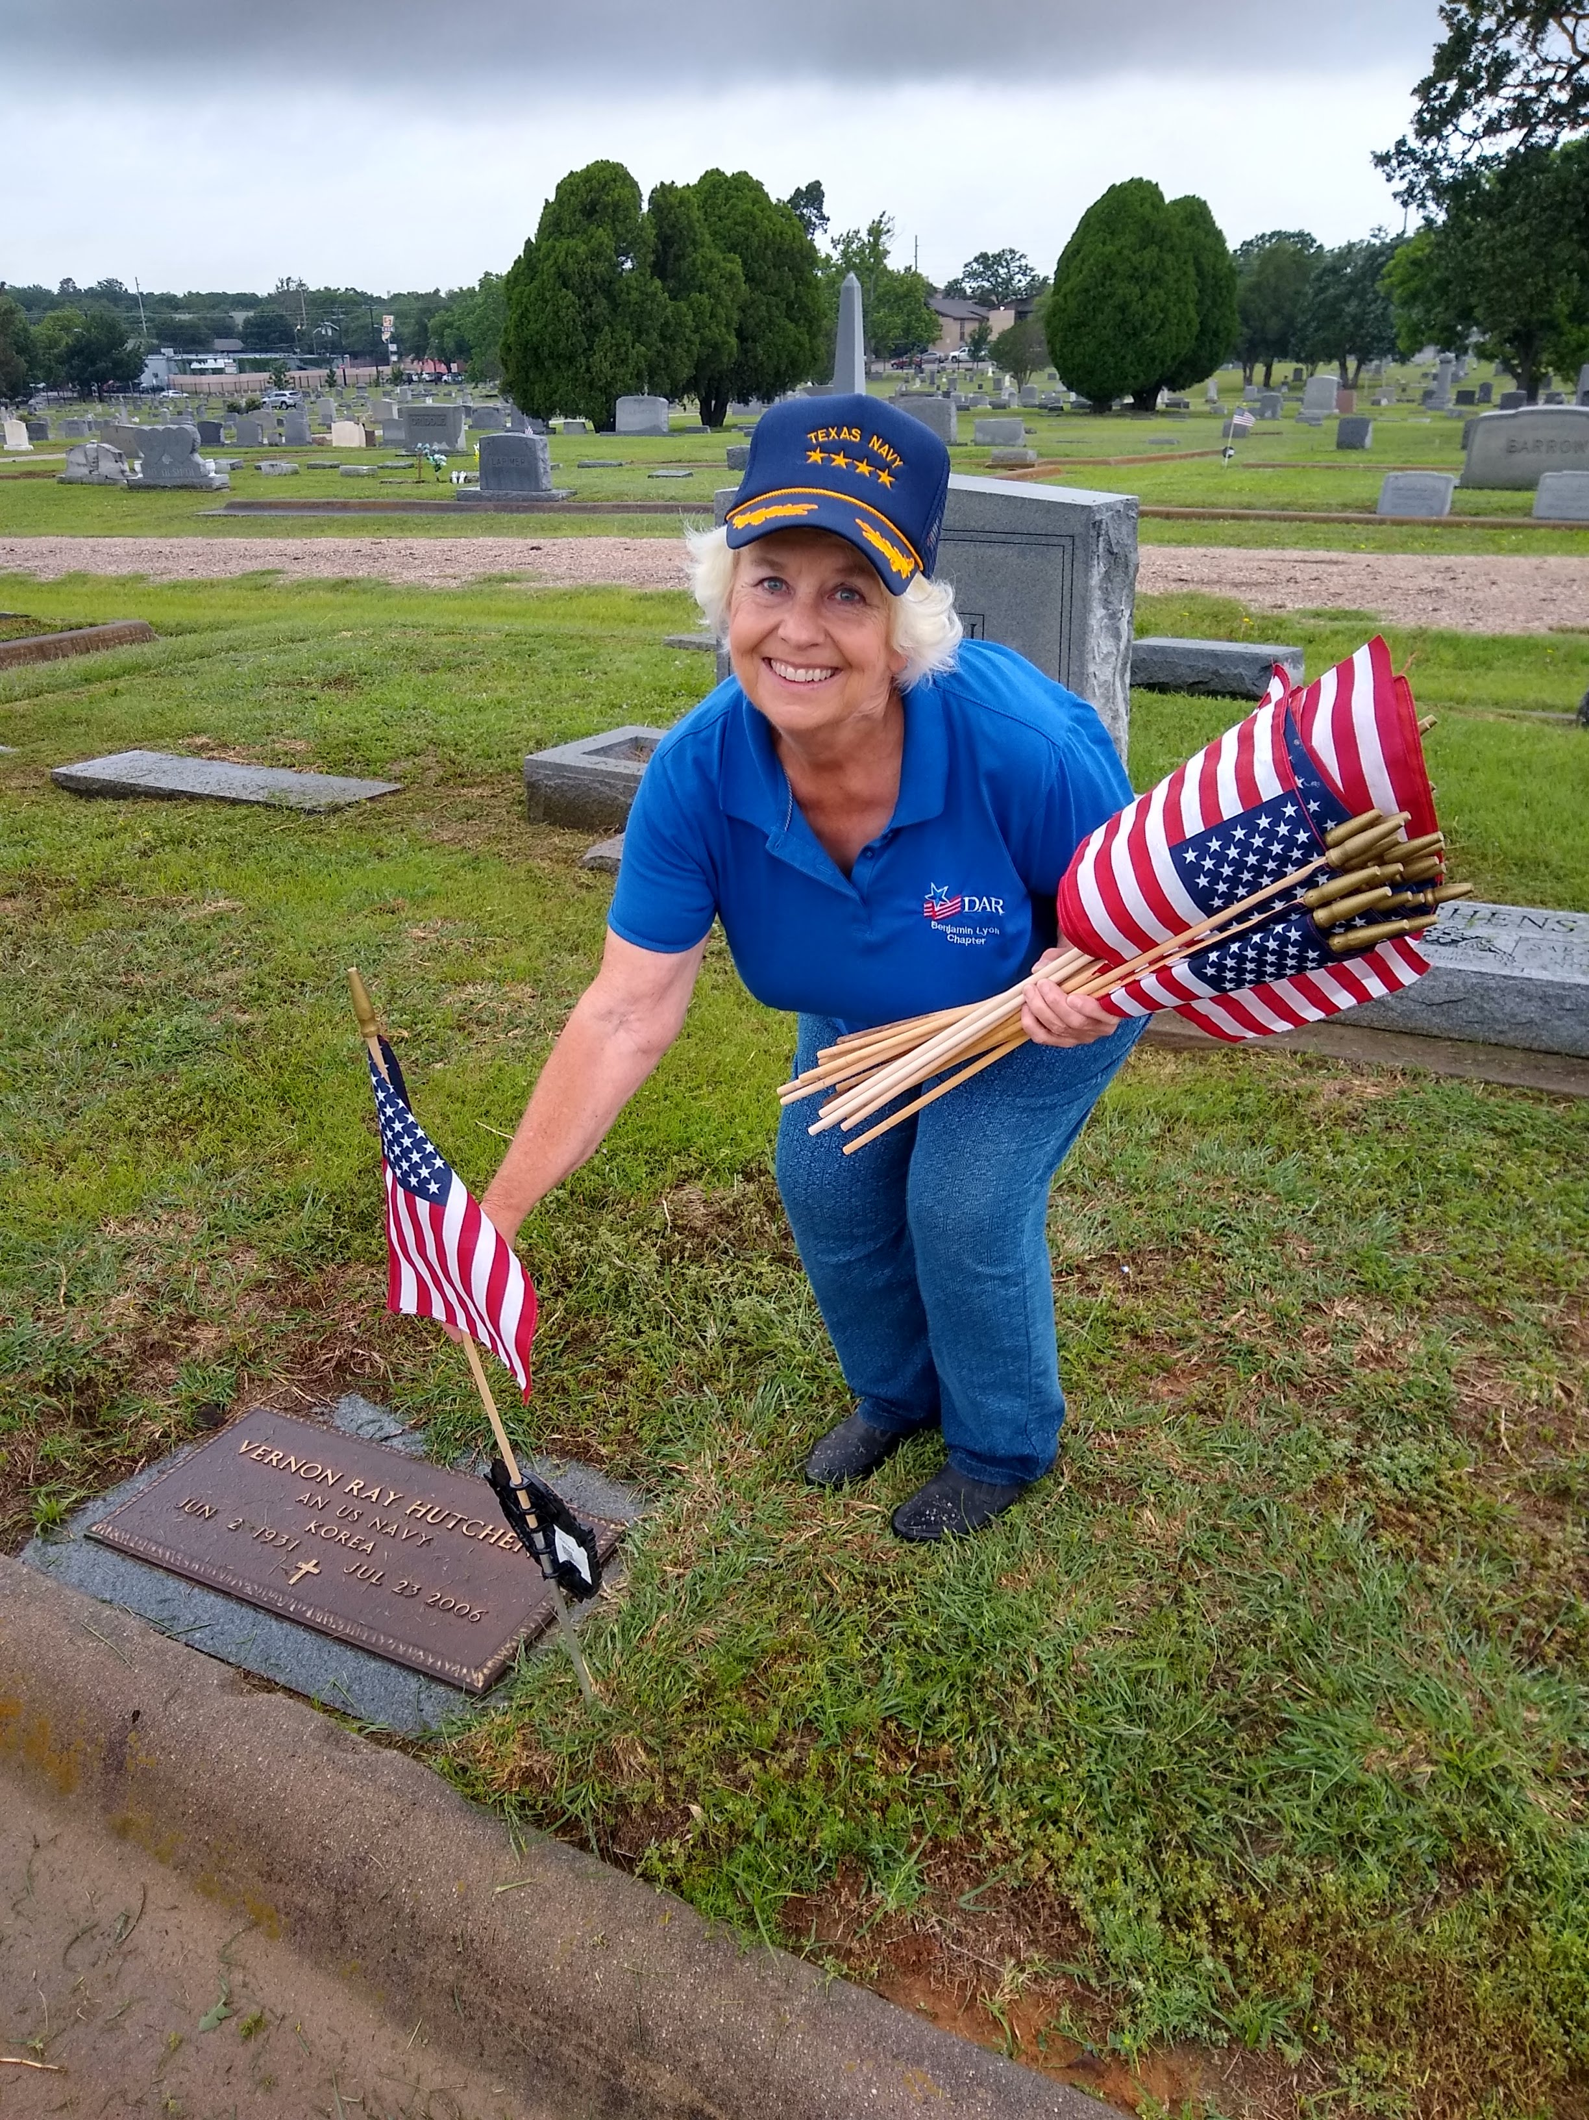
Spring 2020
Benjamin Lyon Chapter of the Daughters of the American Revolution help place flags for Memorial Day 2020.

Slide 27
Denton County
Green Valley Cemetery, Aubrey

Slide 28
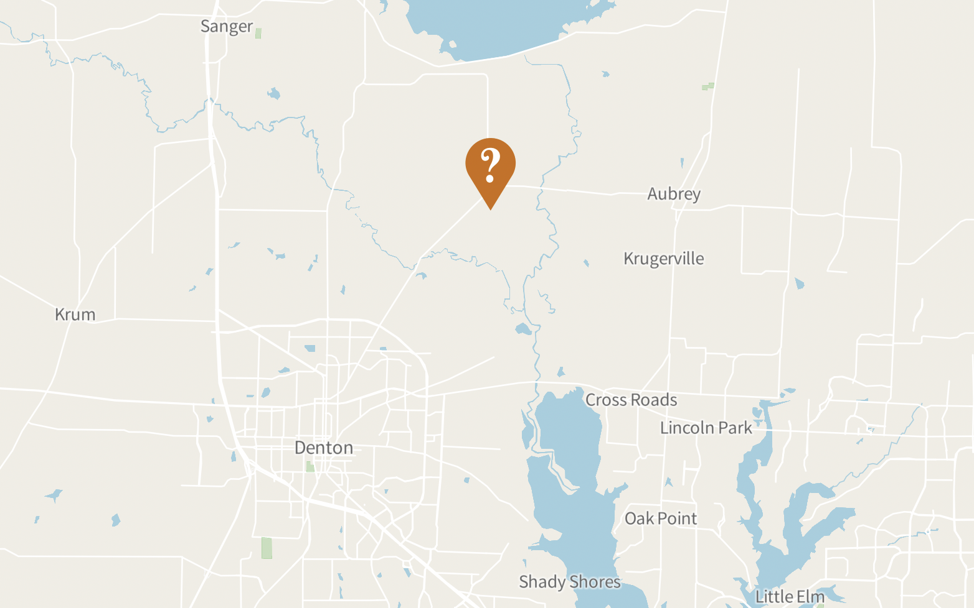
Green Valley Cemetery
22 veterans identified of 313 occupants
7% veterans
Conflicts: 23
Texas Revolution:
Mexican-American:
Civil War: 2
Indian Wars:
Spanish-American:
WW I: 2
WW II: 8
Korea: 5
Vietnam: 4
War on Terror:
Peace time or Unknown: 2
Note: Total exceeds number of identified veterans because some served during more than one conflict.
Address
6670 FM2153
Aubrey, Texas 76227
Adoption cost: $230 + $11.00 for QR Codes = $241 + panel

Slide 30
Denton County
Cooper Creek Cemetery

Slide 31
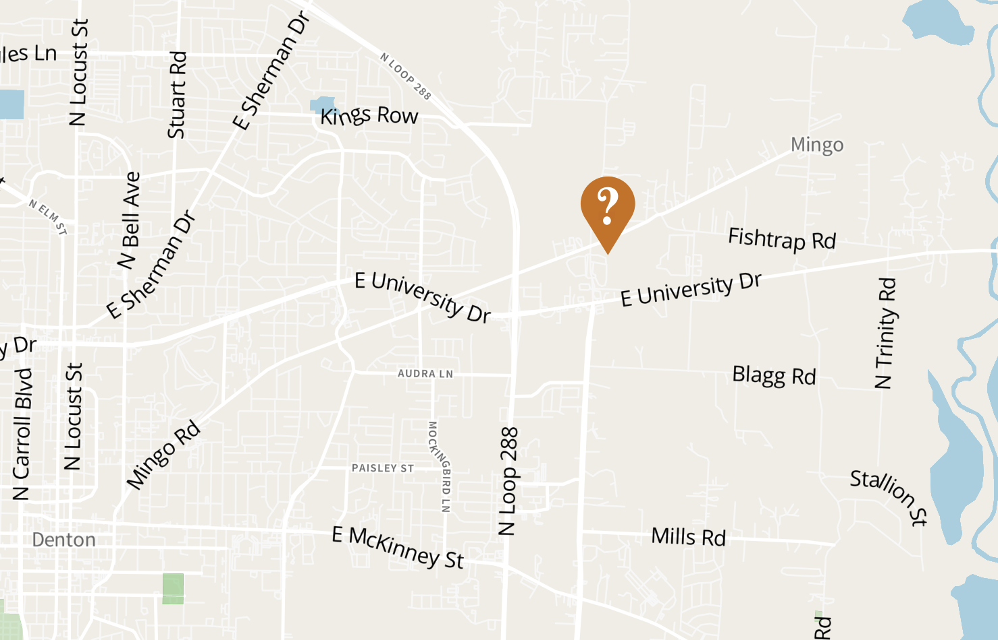
Cooper Creek Cemetery
75 veterans identified of 1003 occupants
7% veterans
Conflict: 78
Texas Revolution:
Mexican-American:
Civil War: 4
Indian Wars:
Spanish-American:
WW I: 8
WW II: 40
Korea: 10
Vietnam: 12
War on Terror:
Peace time or Unknown: 4
Note: Total exceeds number of identified veterans because some served during more than one conflict.
Address
4582 Fishtrap Rd.
Denton, Texas 76208
Adoption cost: $780 + $37.50 for QR codes = $817.50 + panels

Slide 32
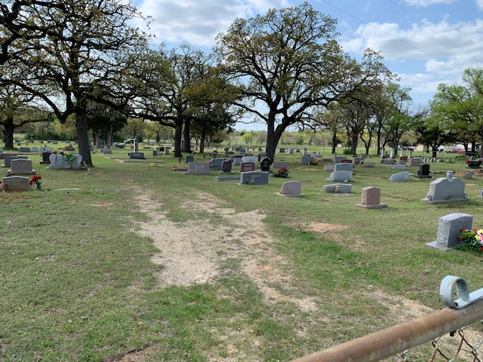

Slide 33
Denton County
Shiloh Cemetery, Corinth

Slide 34
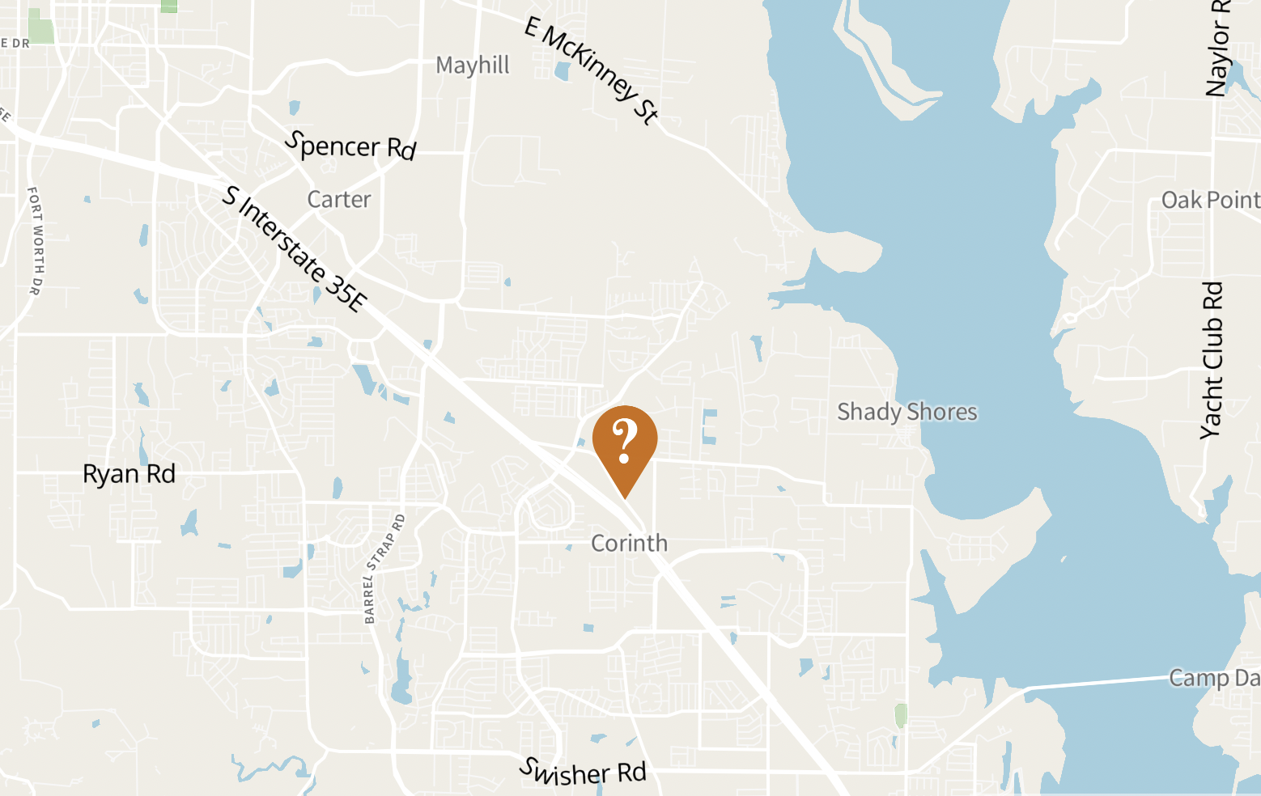
Shiloh Cemetery
71 veterans identified of 579 occupants
12% veterans
Conflicts: 77
Texas Revolution:
Mexican-American:
Civil War: 2
Indian Wars:
Spanish-American:
WW I: 9
WW II: 43
Korea: 7
Vietnam: 13
War on Terror:
Peace time or Unknown: 3
Note: Total exceeds number of identified veterans because some served during more than one conflict.
Address
North side of Shady Shores Rd.
Corinth, Texas
Adoption cost: $770 + $35.50 for QR codes = $805.50 + panels

Slide 36
Denton County
Old Alton Cemetery, Denton

Slide 37
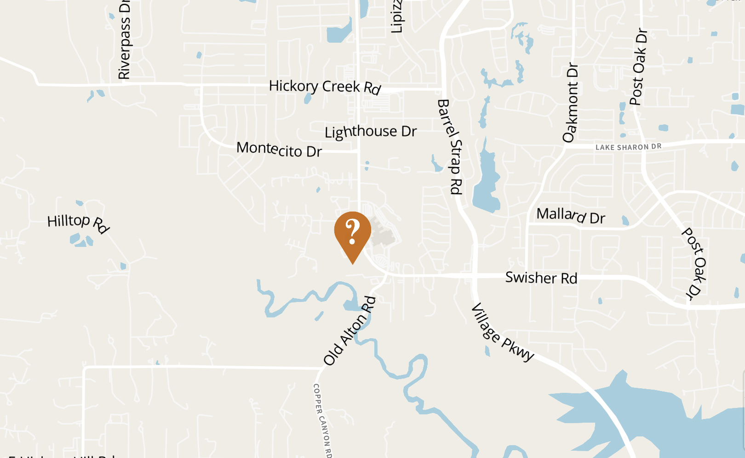
Old Alton Cemetery
63 veterans identified of 728 occupants
8% veterans
Conflicts: 65
Texas Revolution:
Mexican-American:
Civil War: 3
Indian Wars:
Spanish-American:
WW I: 8
WW II: 27
Korea: 3
Vietnam: 11
War on Terror:
Peace time or Unknown: 13
Note: Total exceeds number of identified veterans because some served during more than one conflict.
Address
5720 Teasley Lane
Denton, Texas
Adoption cost: $650 + $31.50 for QR codes = $681.50 + panels

Slide 39
Denton County
Chinn’s Chapel Cemetery,
Highland Village

Slide 40
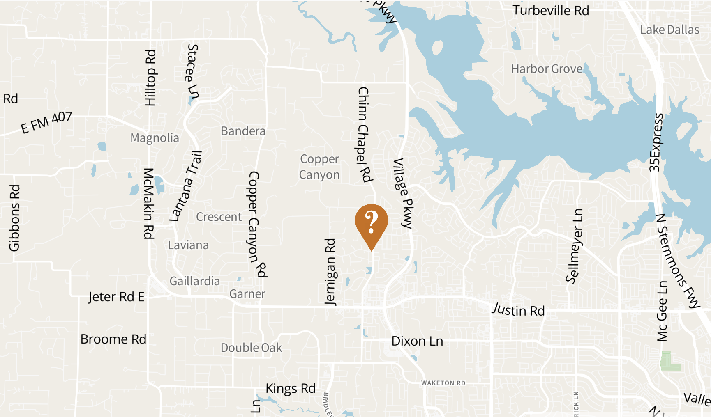
Chinn’s Chapel Cemetery
55 veterans identified of 801 occupants
6% veterans
Conflicts: 55
Texas Revolution:
Mexican-American:
Civil War: 5
Indian Wars:
Spanish-American:
WW I: 7
WW II: 24
Korea: 3
Vietnam: 8
War on Terror:
Peace time or Unknown: 8
Address
Chinn Chapel Rd.
Highland Village, TX 75077
Adoption cost: $550 + $27.50 for QR codes =
$577.50 + panels

Slide 42
Denton County
Flower Mound Cemetery,
Flower Mound

Slide 43
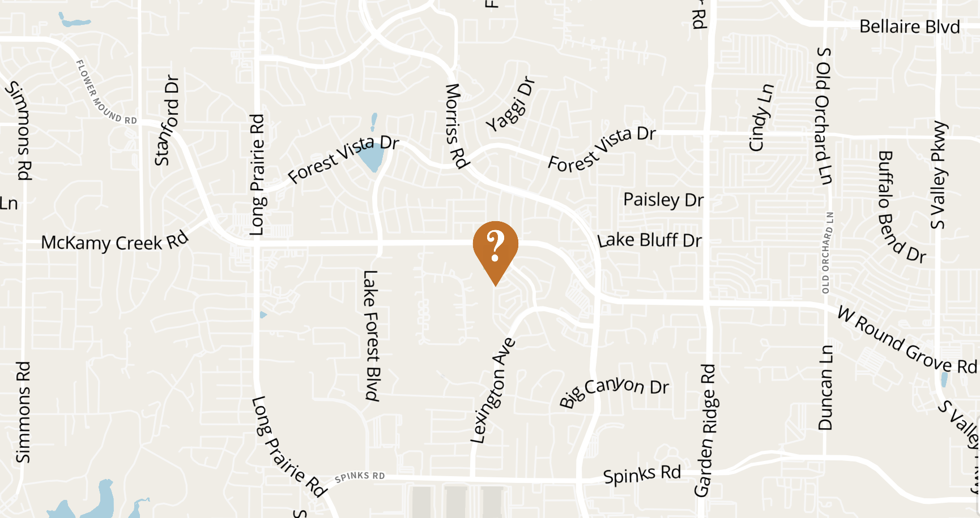
Flower Mound Cemetery
229 veterans identified of 2459 occupants
9% veterans
Conflicts: 250
Texas Revolution:
Mexican-American:
Civil War: 1
Indian Wars:
Spanish-American:
WW I: 11
WW II: 99
Korea: 37
Vietnam: 55
War on Terror: 1
Peace time or Unknown: 46
Note: Total exceeds number of identified veterans because some served during more than one conflict.
Address
1501 Flower Mound Rd
Flower Mound, Texas 75028
Adoption cost: $250 + $114.50 for QR codes =
$364.50 + panels

Slide 45
Denton County
Belew Cemetery, Aubrey

Slide 46
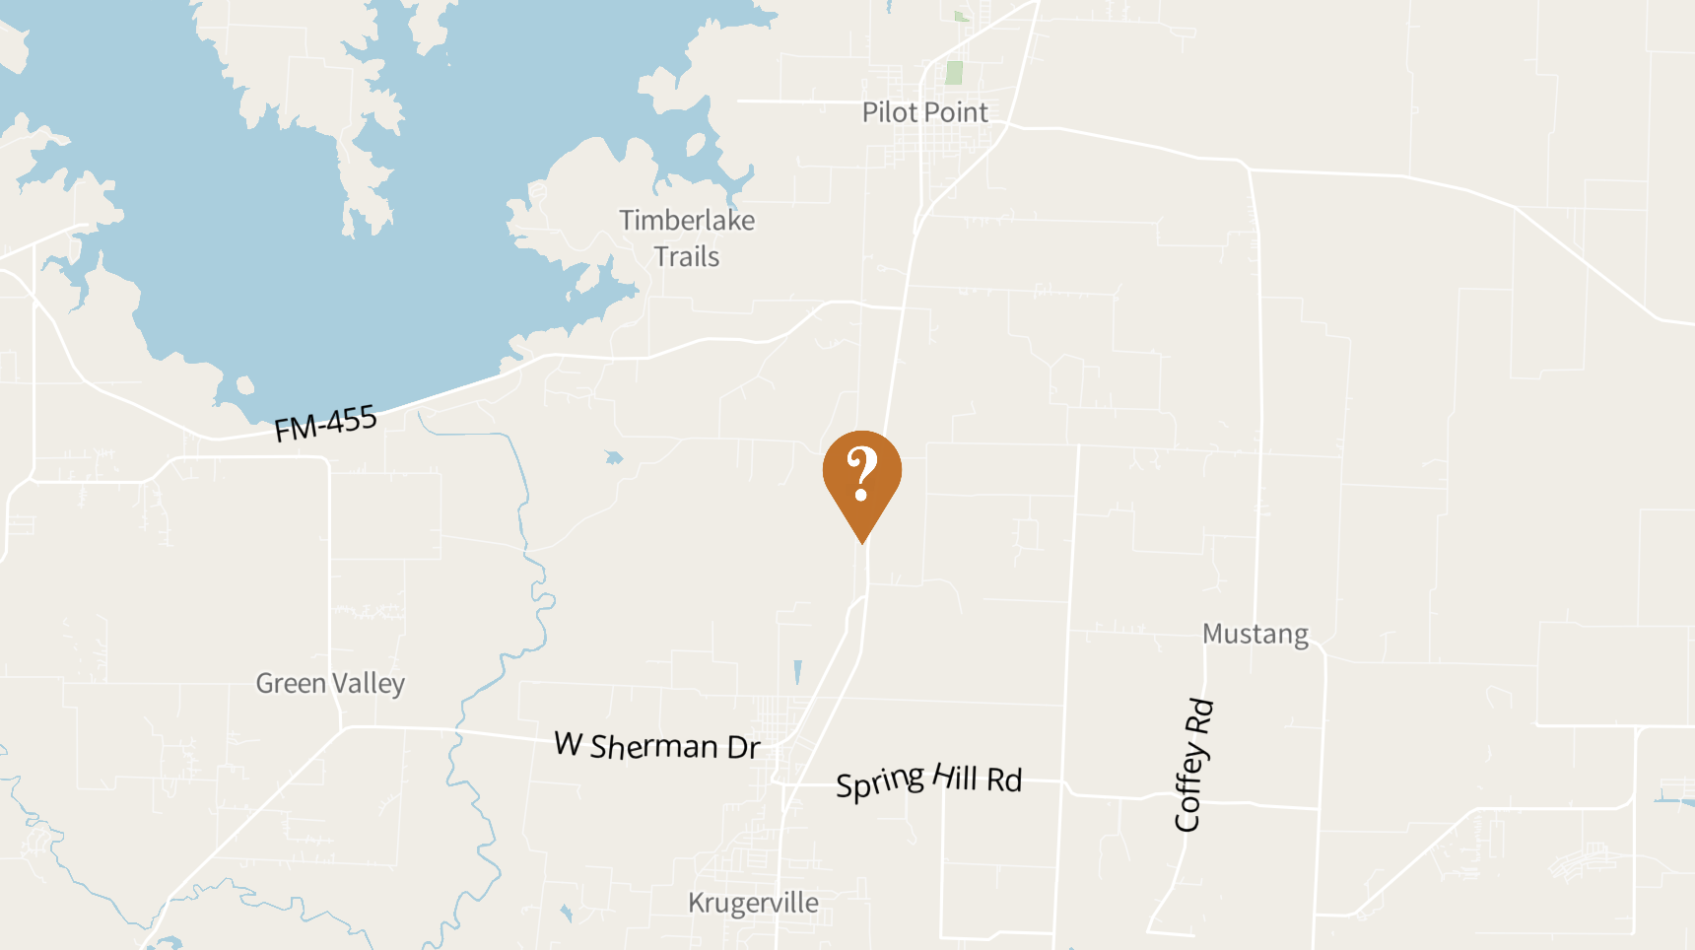
Belew Cemetery
309 veterans identified of 3812 occupants
8% veterans
Conflicts: 318
Texas Revolution:
Mexican-American:
Civil War: 5
Indian Wars:
Spanish-American: 1
WW I: 36
WW II: 142
Korea: 48
Vietnam: 62
War on Terror: 3
Peace time or Unknown: 21
Note: Total exceeds number of identified veterans because some served during more than one conflict.
Address
9500 Belew Rd.
Pilot Point, Texas 76227
Adoption cost: $3180 + $154.50 for QR codes =
$3334.50 + panels

Slide 48
Denton County
Pilot Point Community Cemetery, Pilot Point

Slide 49
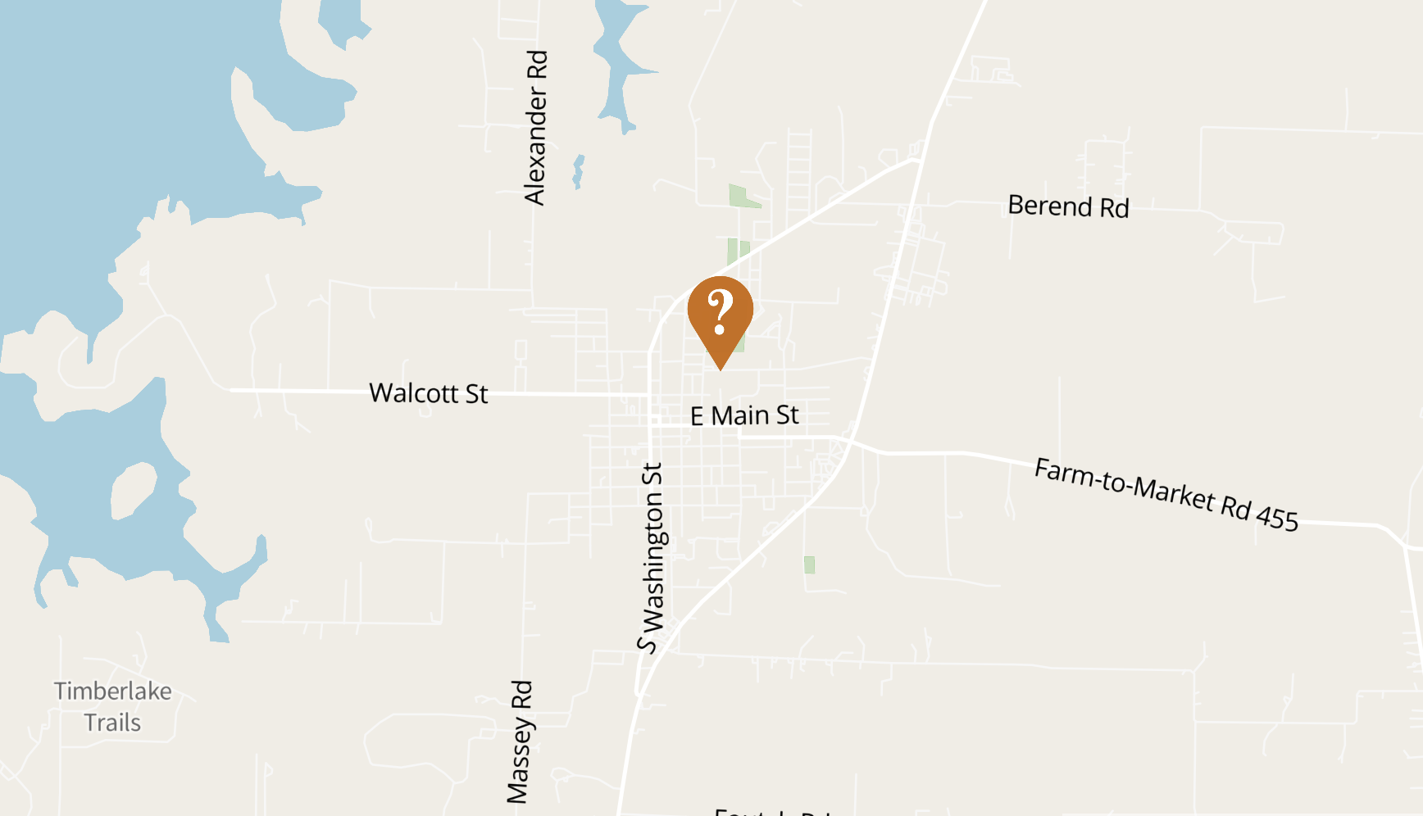
Pilot Point Community Cemetery
52+ (in progress!) veterans identified of 4129 occupants
?% veterans
Conflicts: ?
Texas Revolution:
Mexican-American:
Civil War:
Indian Wars:
Spanish-American:
WW I:
WW II:
Korea:
Vietnam:
War on Terror:
Peace time or Unknown:
Note: Total exceeds number of identified veterans because some served during more than one conflict.
Address
600 N. Prairie Street
Pilot Point, Texas 76258
Adoption cost: $pending

Slide 50
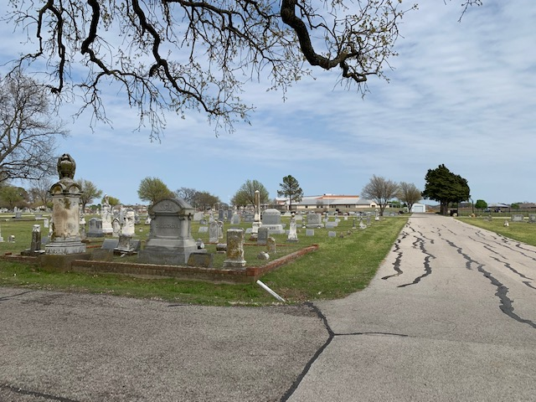
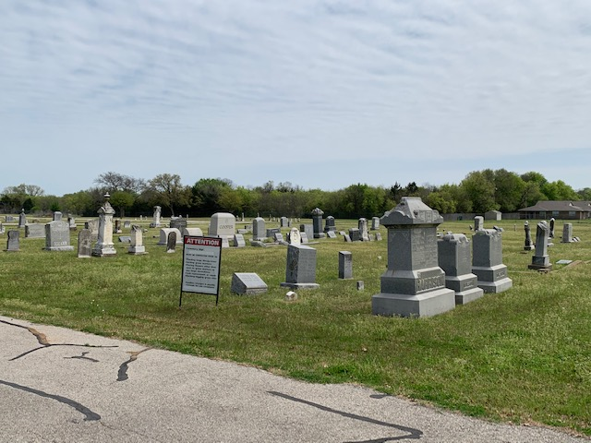
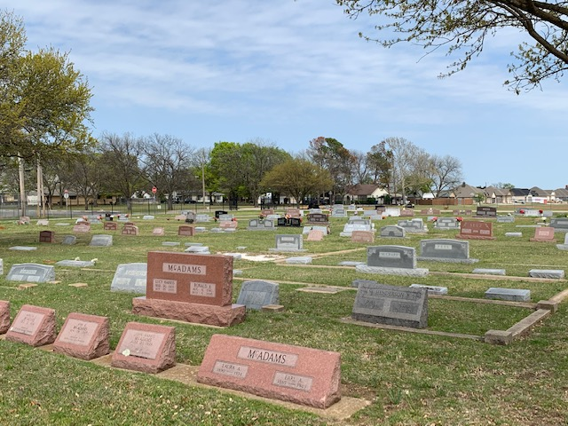
Spring 2021

Slide 51
Denton County
Trinity Cemetery, Denton

Slide 52
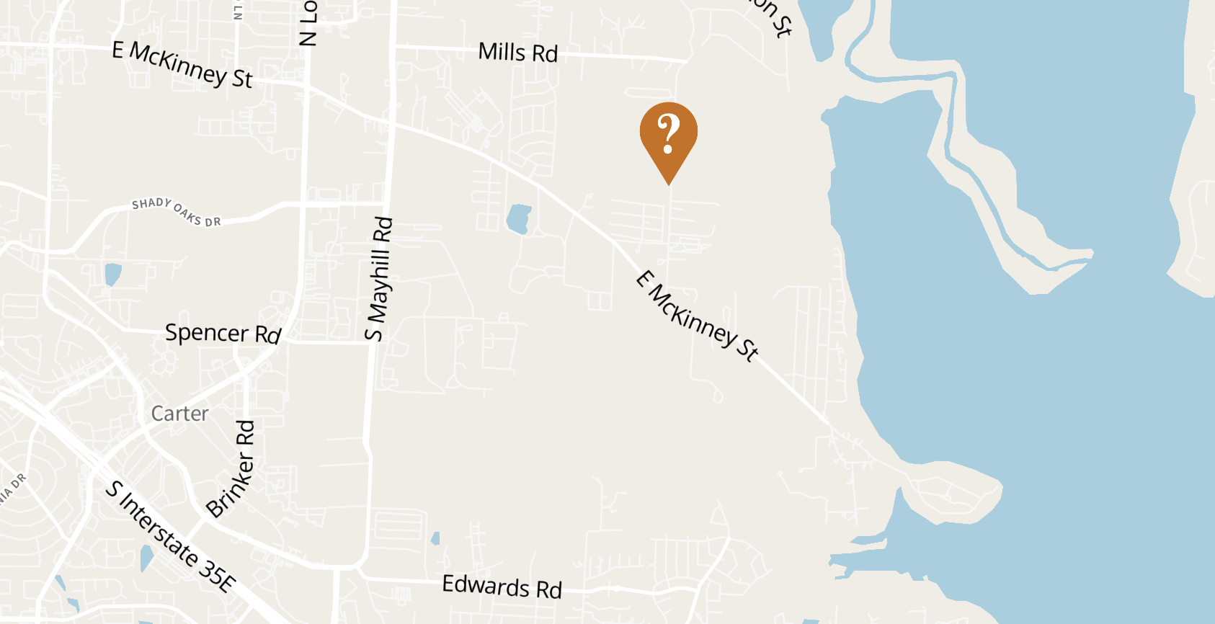
Trinity Cemetery
40 veterans identified of 437 occupants
9% veterans
Conflicts: 40
Texas Revolution:
Mexican-American:
Civil War:
Indian Wars:
Spanish-American:
WW I: 7
WW II: 17
Korea: 3
Vietnam: 5
War on Terror: 1
Peace time or Unknown: 7
Address
742 S. Trinity Rd.
Denton, Texas 76208
Adoption cost: $400 + $20.00 for QR codes =
$420.00 + panels

Slide 53
Winter 2021

Slide 54
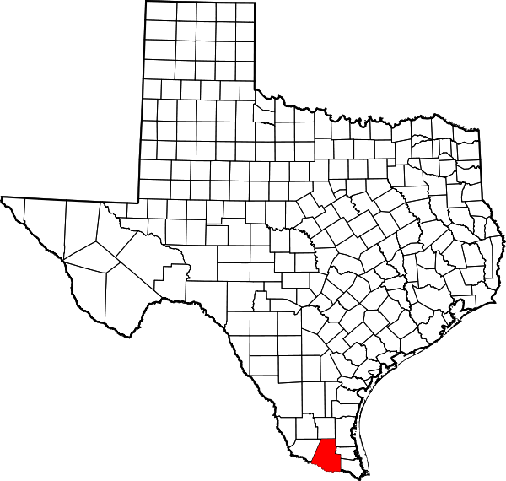
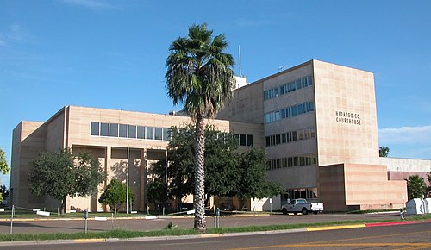
Hidalgo County
McAllen, Texas

Slide 55
Hidalgo County
Roselawn Cemetery, McAllen

Slide 56
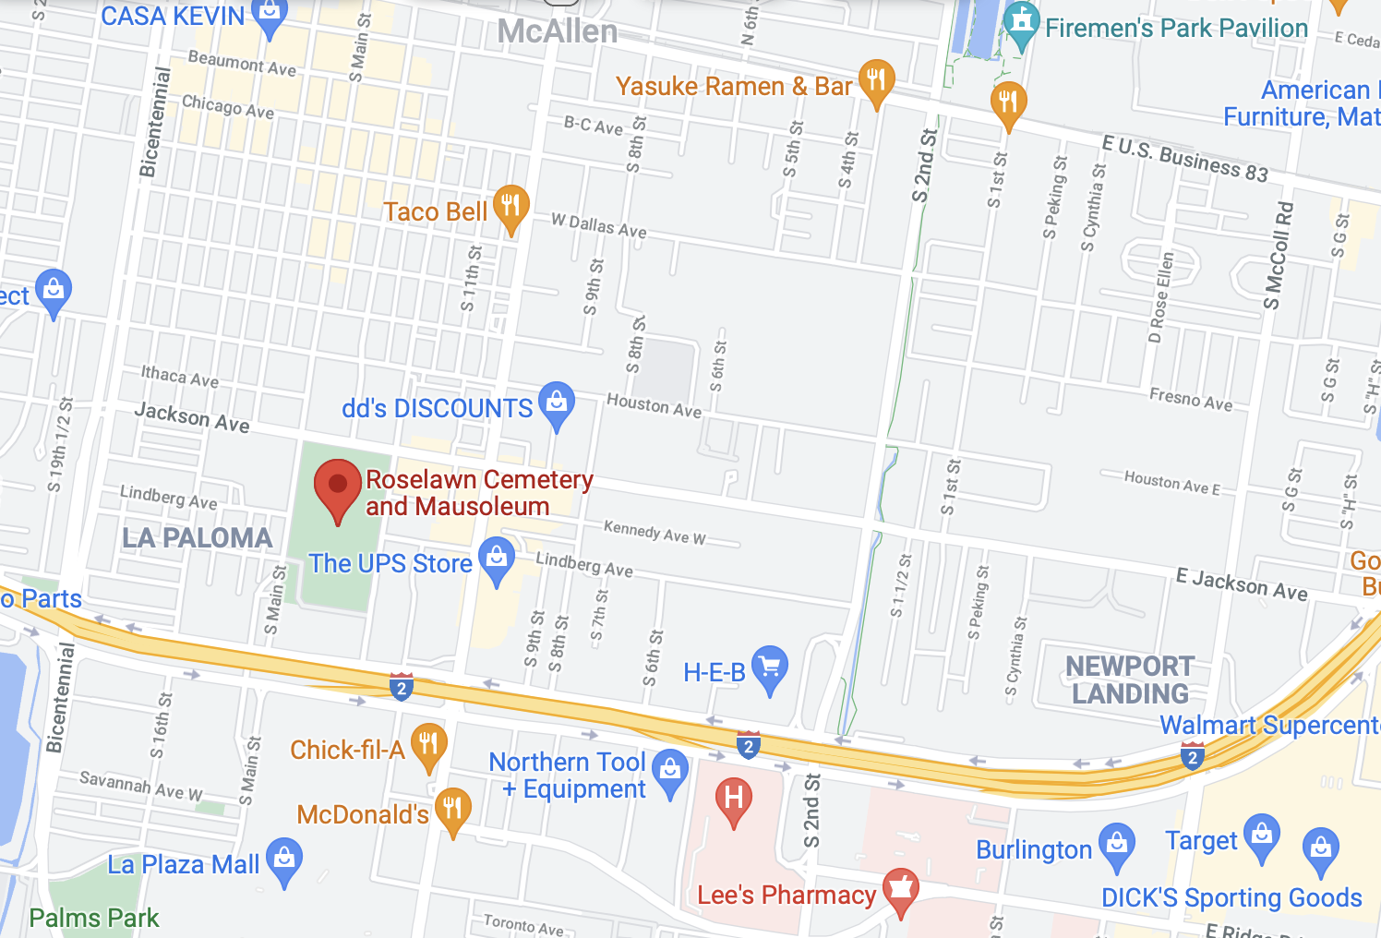
Roselawn Cemetery
In progress veterans identified of 5708 occupants
?% veterans
Conflicts:
Texas Revolution:
Mexican-American:
Civil War:
Indian Wars:
Spanish-American:
WW I:
WW II:
Korea:
Vietnam:
War on Terror:
Peace time or Unknown:
Note: Total exceeds number of identified veterans because some served during more than one conflict.
Address
1201 S Main St
McAllen, TX 78501
Adoption cost: $pending

Slide 57
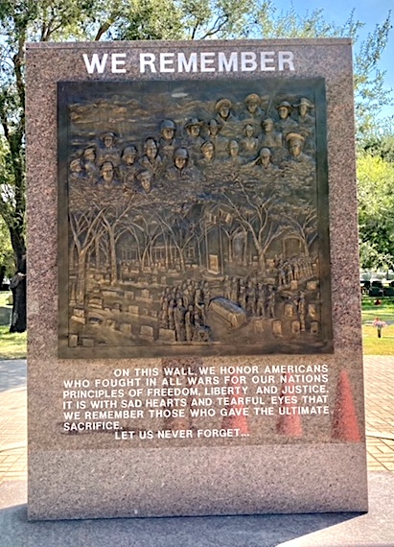
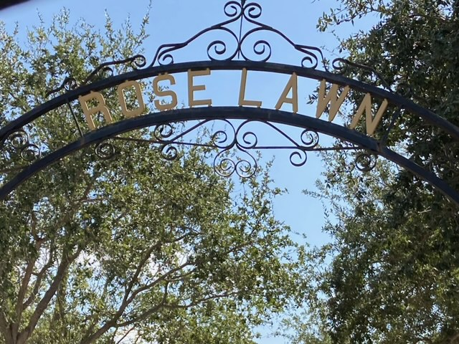
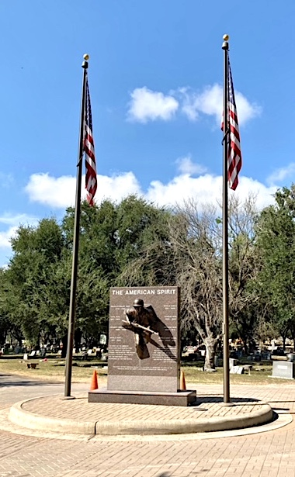
Summer 2021

Slide 58
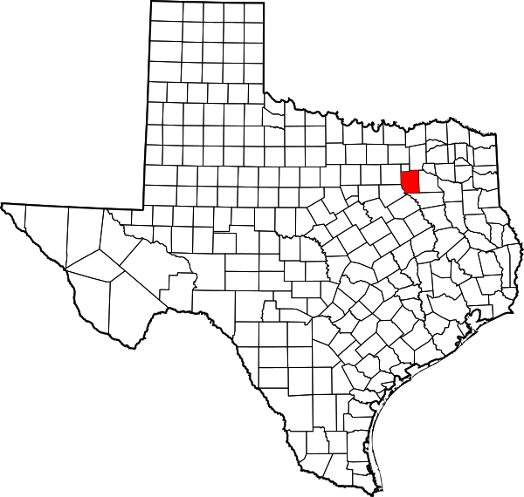
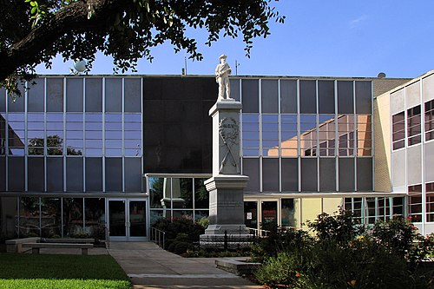
Kaufman County
Kaufman, Texas

Slide 59
Kaufman County
Crandall Cemetery, Crandall

Slide 60
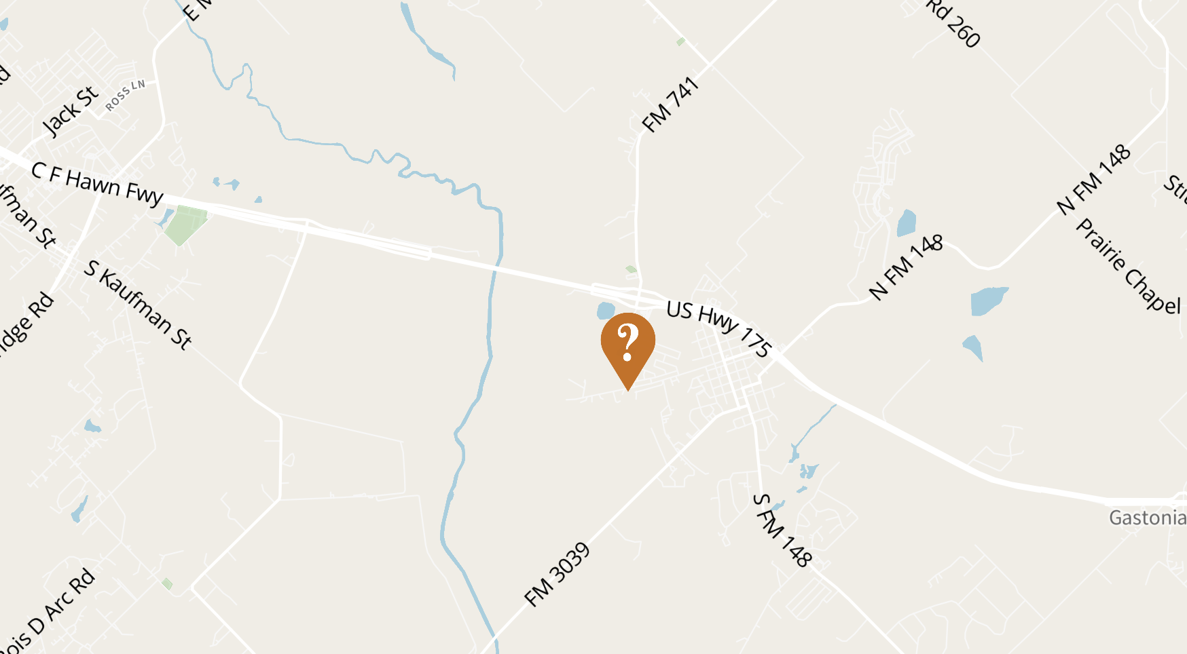
Crandall Cemetery
129 veterans identified of 1928 occupants
6% veterans
Conflicts: 131
Texas Revolution:
Mexican-American:
Civil War: 6
Indian Wars:
Spanish-American: 1
WW I: 21
WW II: 60
Korea: 13
Vietnam: 8
War on Terror:
Peace time or Unknown: 22
Note: Total exceeds number of identified veterans because some served during more than one conflict.
Address
102 Trinity Rd
Crandall, Texas 75114
Adoption cost: $1310 +
$64.50 for QR codes = $1374.50 + panels

Slide 61
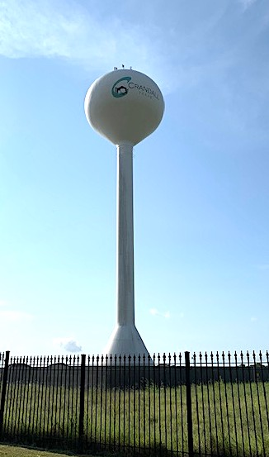
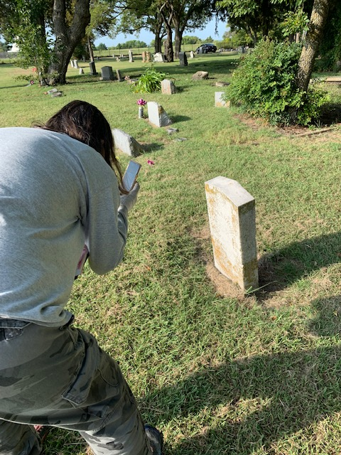
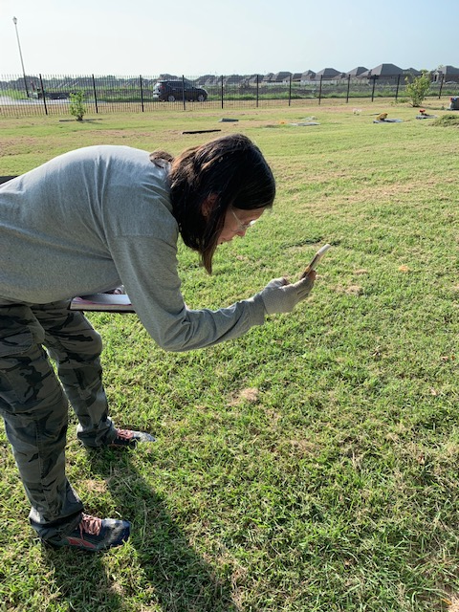
Summer 2021

Slide 62
Kaufman County
Crandall Community Cemetery, Crandall

Slide 63
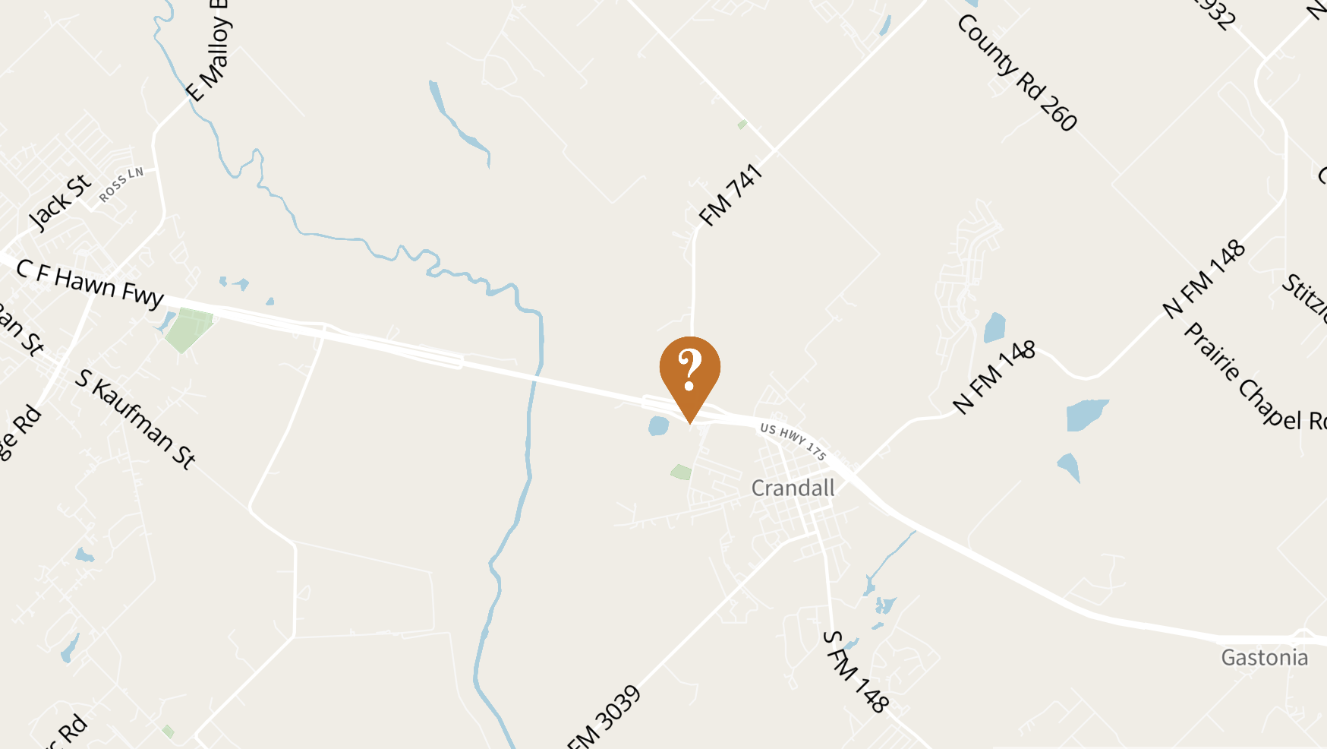
Crandall Community Cemetery
14 veterans identified of 79 occupants
15% veterans
Conflicts: 14
Texas Revolution:
Mexican-American:
Civil War:
Indian Wars:
Spanish-American:
WW I: 1
WW II: 8
Korea:
Vietnam: 4
War on Terror:
Peace time or Unknown: 1
Address
County Road 741 (Forney Exit off US 175)
Crandall, Texas
Adoption cost: $140 +
$7.00 for QR codes =
$147.00 + panel

Slide 65
Kaufman County
Rains Hall Cemetery, Crandall

Slide 66
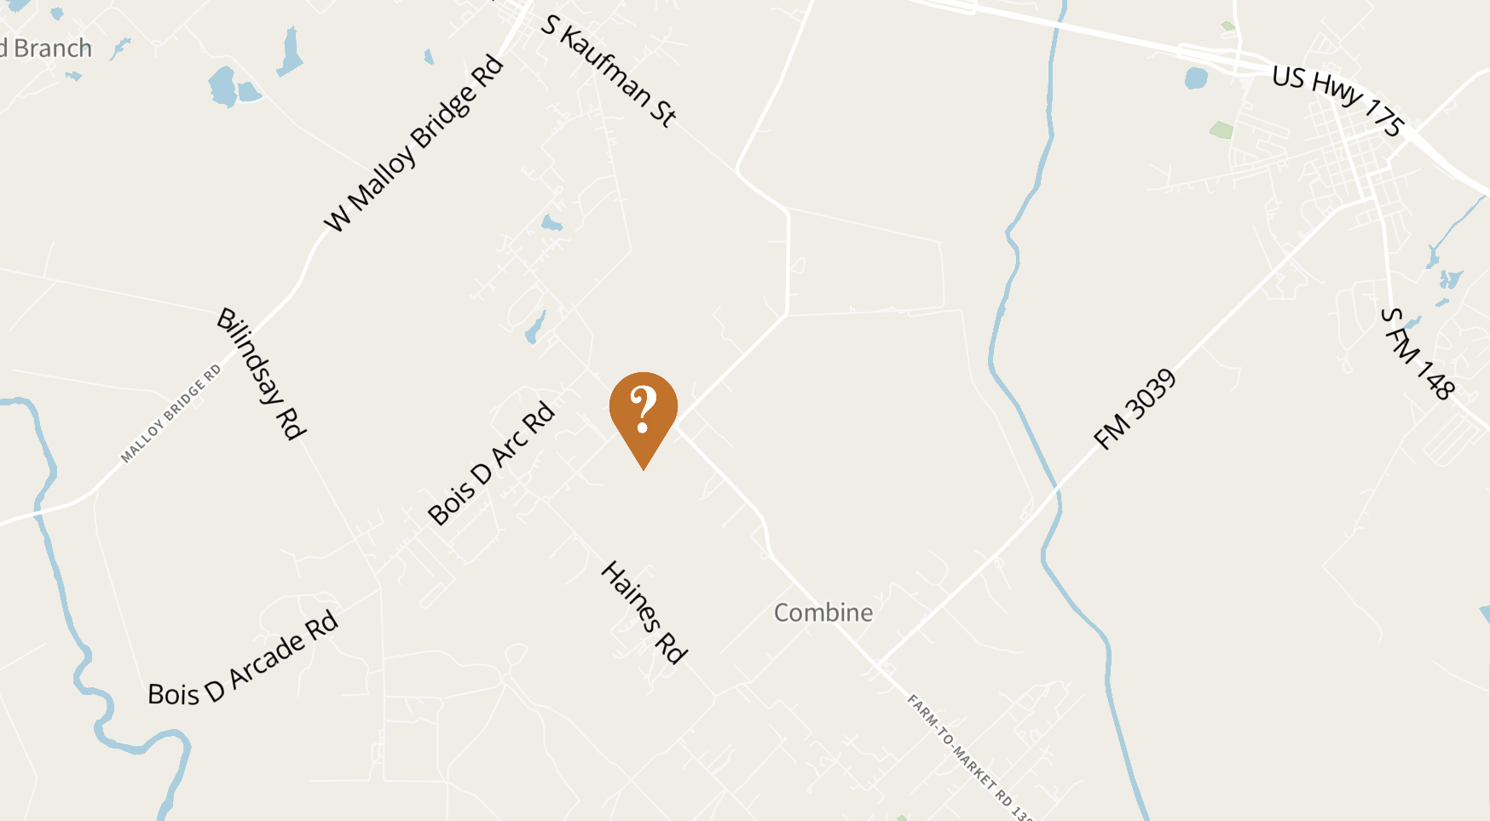
Rains Hall Cemetery
19 veterans identified of 270 occupants
7% veterans
Conflicts: 19
Texas Revolution:
Mexican-American:
Civil War:
Indian Wars:
Spanish-American:
WW I:
WW II: 2
Korea: 5
Vietnam: 1
War on Terror:
Peace time or Unknown: 11
Address
1665 Combine Rd Seagoville, Texas 75159
Adoption cost: $190 +
$9.50 for QR codes =
$199.50 + panel

Slide 67
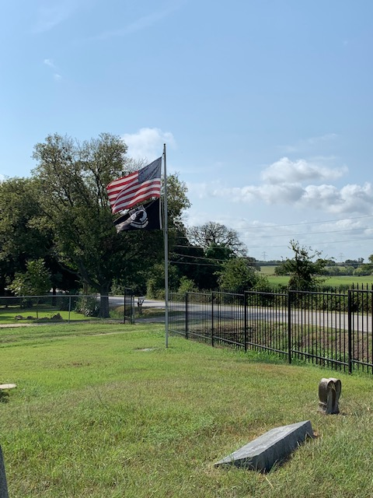
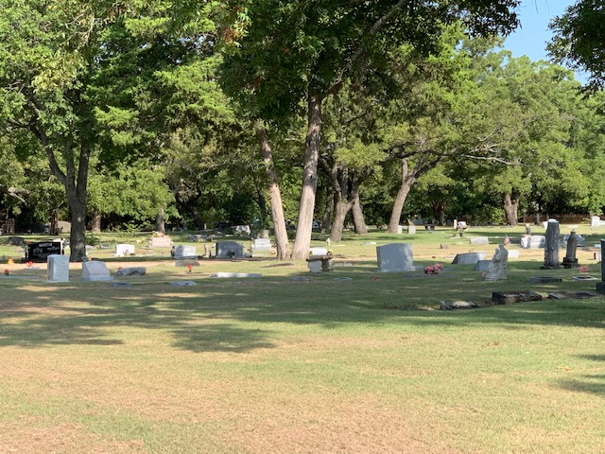
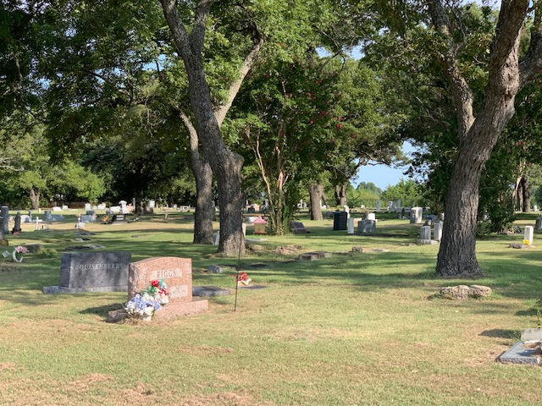
Summer 2021

Slide 68
Kaufman County
Pleasant Grove, Combine

Slide 69
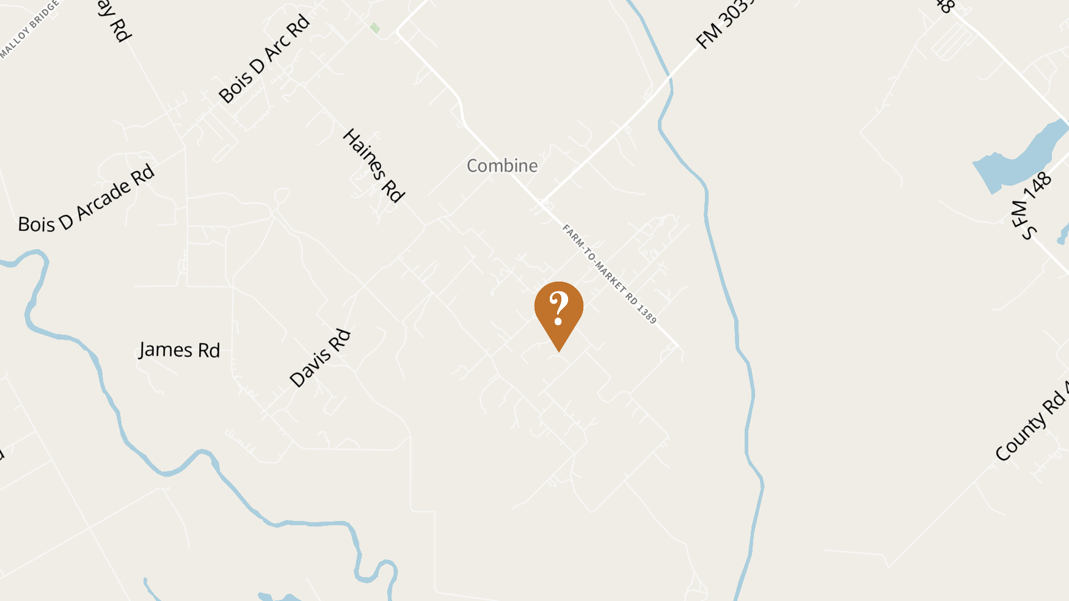
Pleasant Grove Cemetery
40 veterans identified of 523 occupants
7% veterans
Conflicts: 41
Texas Revolution:
Mexican-American:
Civil War:
Indian Wars:
Spanish-American:
WW I: 2
WW II: 18
Korea: 5
Vietnam: 11
War on Terror:
Peace time or Unknown: 5
Note: Total exceeds number of identified veterans because some served during more than one conflict.
Address
318 Lanier Road
Combine, Texas 75159
Adoption cost: $410 +
$20.00 for QR codes =
$430.00 + panel

Slide 70
Summer 2021

Slide 71
Kinney County

Slide 72
Kinney County
Seminole Indian Scouts Cemetery, Brackettville

Slide 73
Seminole Indian Scouts Cemetery
106 veterans identified of 436 occupants
24% veterans
Conflicts: 117
Texas Revolution:
Mexican-American:
Civil War:
Indian Wars: 36
Spanish-American: 5
WW I: 23
WW II: 28
Korea: 7
Vietnam: 6
War on Terror:
Peace time or Unknown: 12
Note: Total exceeds number of identified veterans because some served during more than one conflict.
Address
FM 33348
Brackettville, Texas 78832
Adoption cost: $1170 +
$53.00 for QR codes =
$1223.00 + panels

Slide 74
Four Medal of Honors Buried Here
Go to: https://txveterans.org
Click on View Their Stories (red button)
Click on Search
Check: Medal of Honor
AND
Check: Cemetery-Seminole Indian Scouts
Click on Search (bottom of page)
Results
Yes, this cemetery is host to 4 MOH recipients!
Read their Bios!

Slide 75
McLennan County
Waco, Texas

Slide 76
McLennan County
Moore Cemetery, Chalk Bluff

Slide 77
Moore Cemetery
139 veterans identified of 820 occupants
17% veterans
Conflicts: 144
Texas Revolution: 1
Mexican-American: 1
Civil War: 2
Indian Wars:
Spanish-American:
WW I: 8
WW II: 55
Korea: 19
Vietnam: 19
War on Terror:
Peace time or Unknown: 39
Note: Total exceeds number of identified veterans because some served during more than one conflict.
Address
5137 Gholson Rd.
Chalk Bluff, Texas 76705
Adoption cost: $1390 +
$69.50 for QR codes =
$1459.50 + panels

Slide 78
Summer 2021

Slide 79
Tarrant County
Fort Worth, Texas

Slide 80
Tarrant County
Thompson Public Cemetery, Westworth Village

Slide 81
Thompson Public Cemetery
3 veterans identified of 79 occupants
4% veterans
Conflicts: 3
Texas Revolution:
Mexican-American:
Civil War: 2
Indian Wars:
Spanish-American: 1
WW I:
WW II:
Korea:
Vietnam:
War on Terror:
Peace time or Unknown:
Address
6505 Westworth Blvd
Westworth Village, Texas
Adoption cost: $30 +
$1.50 for QR codes =
$31.50 + panel

Slide 82
Spring 2021

Slide 83
What are RTF Hosts and Researchers?
A group of individuals or organizations that have agreed to Host and perform research at a cemetery as their RTF project.
The program is divided into two parts.
Organizations can select one or both parts of the RTF program as their responsibility.

Slide 84
Host Program
Record the compass points (Degree/Min/Sec or Lat/Long) the gravesites of Veterans in your Host cemetery.
Take photos of each military marker or other indication that the deceased is a veteran.
Place Patriot Medallions and wayside panels in the host cemetery.
Place and remove the American Flags for Memorial Day, the Fourth of July and Veterans Day.

Slide 85
Research Program
Research the history of each veteran buried in your host cemetery.
Document the stories and/or profiles of each veteran for entry into the Texas Veterans Hall of Fame (TVHOF) database.

Slide 86
Guidelines for Military Bio
1. Be brief (readable within 2 min; no longer than 2 pages)
2. Write in third person
3. Start with personal information Personal info (name/nickname, place and date of birth, service dates, highest rank, branch and location of station, survivors/family info: parents, wife, children)
4. Military deployment summary (dates, battles, assignments, duty titles)
5. Training and education (civilian experience (e.g., Freemason, woodman, blacksmith); areas of expertise, employment)
6. Include additional information such as awards and accomplishments, as well as any interesting or impressive details of how various ranks were attained.
7. Burial details (identify the cemetery, GPS location, cause of death (if available), include picture of gravesite if deceased)
8. Source(s) used to collect data
9. Bio should reflect veterans’ lives in a positive manner.

Slide 87
Bio Template (2-pages)
Personal info (name/nickname, place and date of birth, service dates, highest rank, branch and location of station, survivors/family info: parents, wife, children):
Name: Date of Birth: Place of Birth:
Date of Death (If deceased):
Cemetery Name (If deceased):
Cemetery Location with address and GPS Coordinates (pictures are appreciated)
Military Service-Military deployment summary (dates, battles, assignments, duty titles) Military Branch:
Dates of Military Service:
Rank at Discharge: Era of Service (i.e., Vietnam):
List places of assignments with job descriptions and dates (list in chronological order)
List military awards
Summarize Education
Civilian job descriptions and major accomplishments
Civilian Awards (include, local, state and national/Federal Awards)
Sources (List all sources if possible)

Slide 88
Author Disclaimer
Name: Date: Contact Info (Phone or Email Address): Current Address (optional):
Organization Represented:
General Disclaimer (if used for The Texas Veterans Hall of Fame).
This is a non-profit project developed by and controlled by the Texas Veterans Hall of Fame. Although we enter into collaborative associations with many supporting organizations, this site is not owned or operated by any Government body. All information found on this site has been obtained through fair use public contributions and compiled information from family, friends and historians to preserve the history of Texas Veterans. We've done our best to craft a valuable and historic path to honor our Texas Veterans for their service, sacrifices and accomplishments, however, we make no claims of 100% accuracy. If you wish to submit corrections or suggestions, please contact us at info@tvhof.org

Slide 89
Who pays for Patriot Medallions and panels?
The TVHOF will help with fundraising to purchase the markers and panels.
Patriot Medallions with US Flag = $10
QR code = $0.50
Wayside panels = $100 each (front and back)
TVHOF will be also responsible for the training of each Host organization.
If you are interested, email: info@txveterans.org

Slide 90
Don’t Like Our Choices— Select your own!
There are roughly 50,000 cemeteries in Texas’ 254 counties.
Choose one or more!
To become the Host and/or Researcher: info@txveterans.org
Take pictures of all the veterans’ gravesites, record the GPS of each in DMS (degree, minute, second) or in latitude/longitude.
Complete an Excel file with the following:
Last name, first name, birth/death dates, conflict(s), veteran’s service branch/duties, name of cemetery and location/city/county, and GPS
Arrangements will be made to add the pictures of the gravesites to the database.
Research and write a short bio on each veteran.

Slide 91
Summary (as of 11 Sept 2021)
Burials identified: 3288
Patriot Medallions pending purchase: 2633
Cemeteries: 21
Counties: 7
State: 1

Slide 92
Remember Them Forever (RTF):
https://txveterans.org/remember-them-forever/

